Slide 1
Palo Verde Community College District
Comprehensive Educational Plan
2025-2033
CEP Task Force Meeting #1
Kick-off and Data Presentation, Part One
August 29, 2024

Slide 2
Welcome and Introductions
Welcome
  Dr. Bruce Moses
  Clint Cowden
Introductions
  Ad hoc CEP Task Force Members
Higher Education Consulting Team Overview
  Dr. Lori Bennett
  Nga Pham

Slide 3

Discussion Activity #1
Why Spend Time on Long-Term Planning?
  Purpose?
  Benefits?

Slide 4
Comprehensive Educational Plan 2025-2033
Overview
The Comprehensive Educational Plan:
  provides visionary direction and establishes priorities for the College for the next eight years
  aligns with statewide initiatives and local community needs
  integrates the various planning efforts that currently exist in the College
  serves as a guide for program planning, technology planning, facilities improvements, resource allocation, and other emerging plans of the College

Slide 5
Integrated Planning
Mission
Comprehensive Educational Plan
Strategic Plan
Technology Plan
Facilities Plan
Resource Allocation
Outcomes Assessment
Program Plans
Other Annual College Plans

Slide 6
CEP aligns with 2024 updated Accreditation Standards
Emphasis on:
  integrated planning, resource allocation, decision-making, and short- and long-term operational planning
  meaningful discussion of equity data and actions to close equity gaps
  Regular review of qualitative and quantitative data to evaluate progress on achieving the mission, enhanced understanding of student’s experience, informing short and long-term planning
  how outcomes of a process are used to innovate and improve

Slide 7
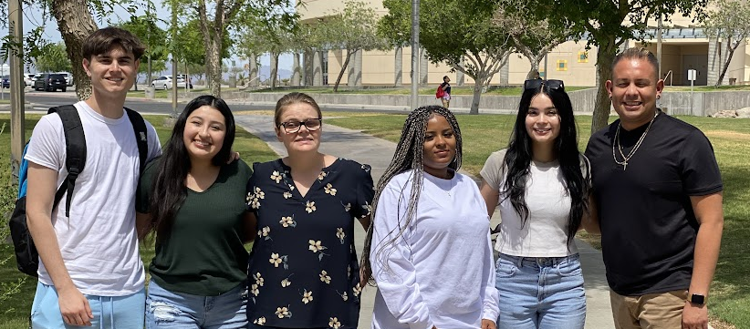
Discussion Activity #2
What adjectives would describe your hopes or expectations for this CEP planning process?

Slide 8
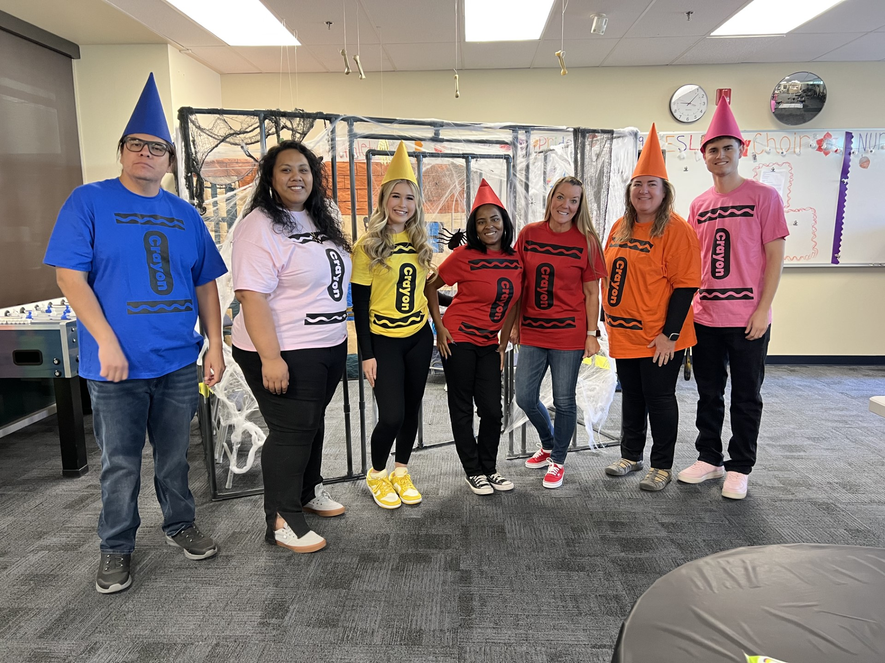
Comprehensive Educational Plan Process
Collaborative
Data-Informed
Transparent
Student Focused

Slide 9
CEP Development Process:
Steps and Roles
Step 1: Prepare and Discover
Step 2: Analyze, Interpret, and Reflect
Step 3: Innovate, Aspire, and Set Goals
Step 4: College Review and Board Approval

Slide 10
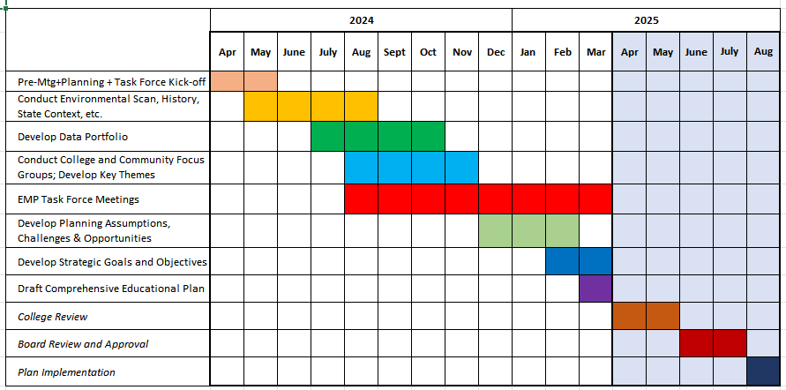
CEP Planning Process Timeline 2024-2025

Slide 11
Role of the ad hoc CEP Task Force
The CEP Task Force serves as an ad hoc work group to help guide development of the Comprehensive Educational Plan
  Commit to the project and prioritize attending all Task Force meetings
  Actively engage in data analysis and discussions
  Represent the college and/or community (not just your own program)
  Work in collegially and collaboratively
  Keep student success, equity, and community needs at the center of discussions
  Have FUN!!!

Slide 12
CEP Process
Communication and Webpage
CEP Webpage
Monthly Updates
Superintendent/President’s Communication
Cabinet, Councils, Committees, and Departments

Slide 13
Internal Scan Data Presentation
Good News
Gaps
Items of Interest

Slide 14
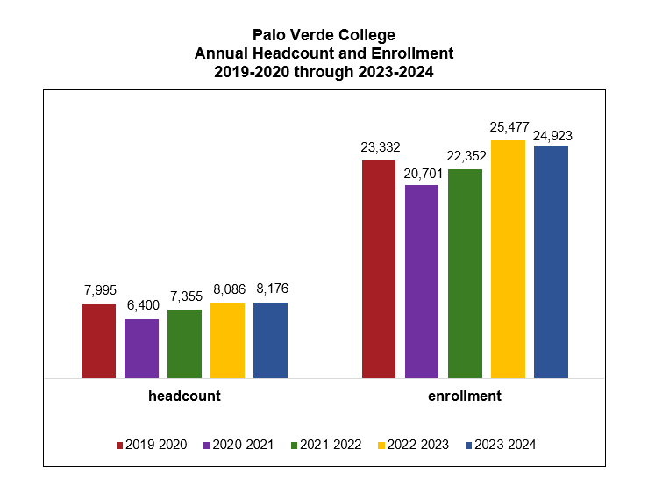

Slide 15
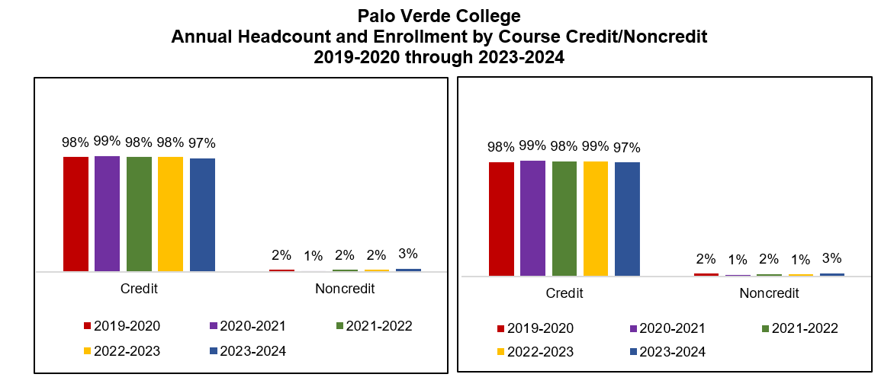

Slide 16
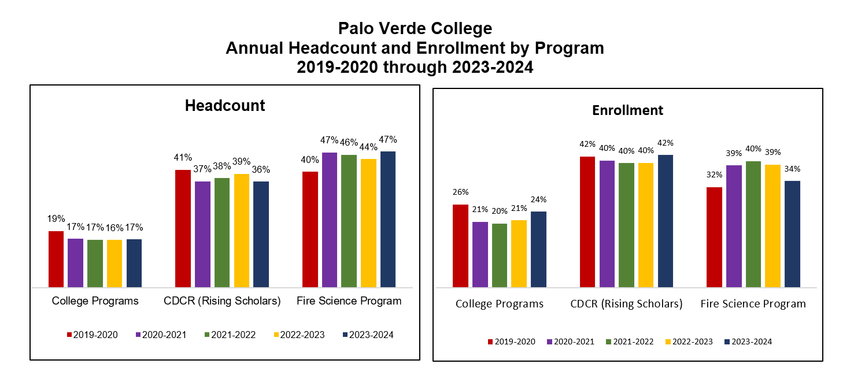

Slide 17
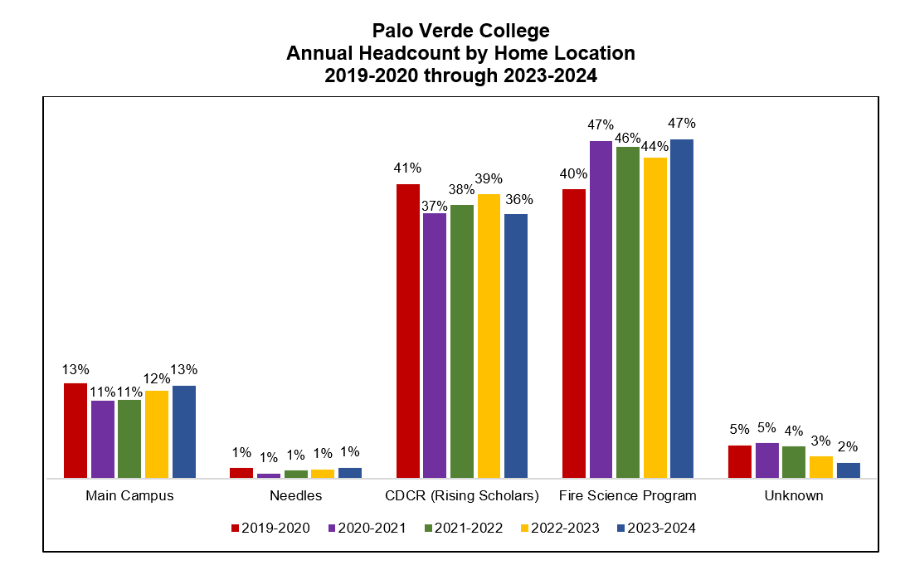

Slide 18
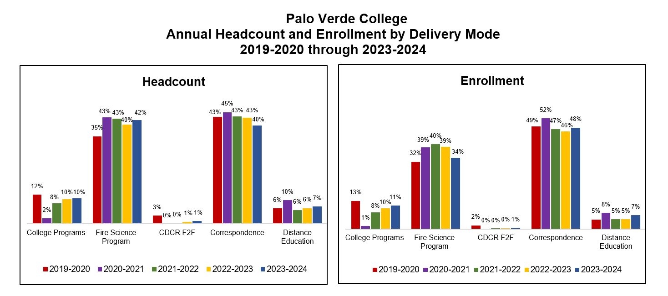

Slide 19
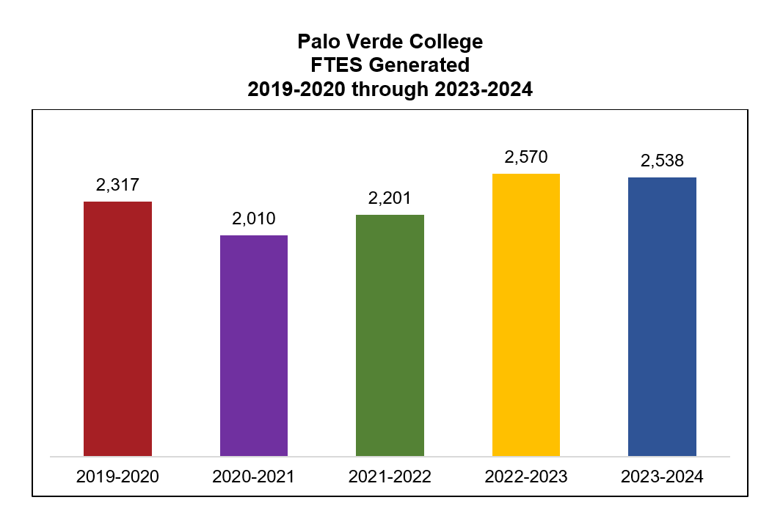

Slide 20
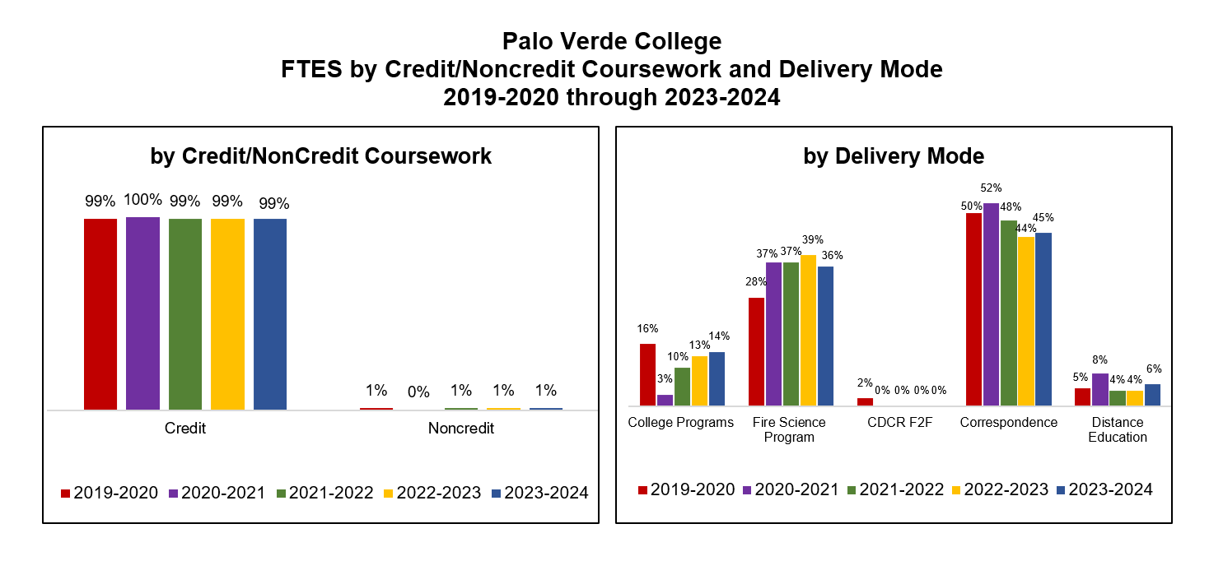

Slide 21
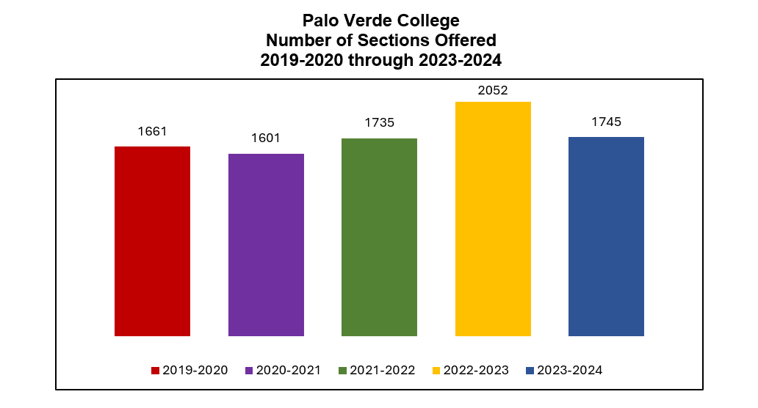

Slide 22
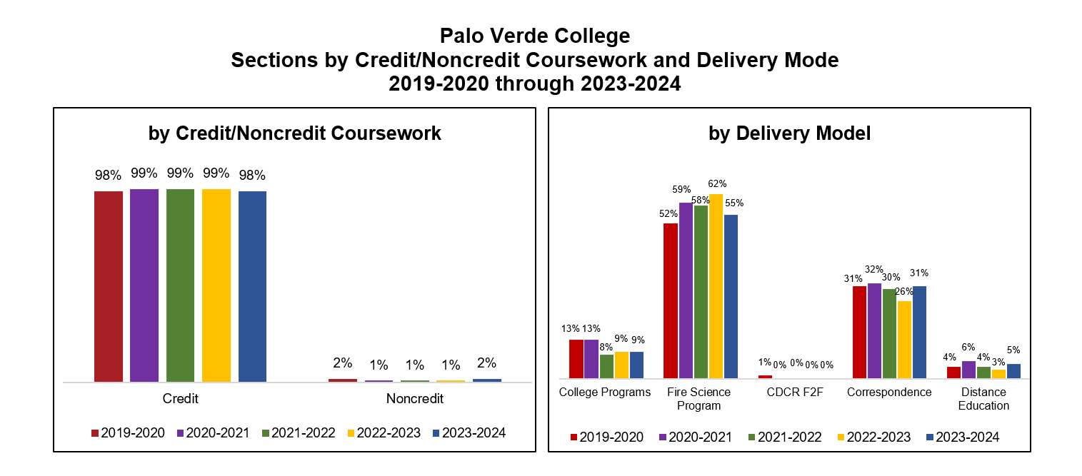

Slide 23
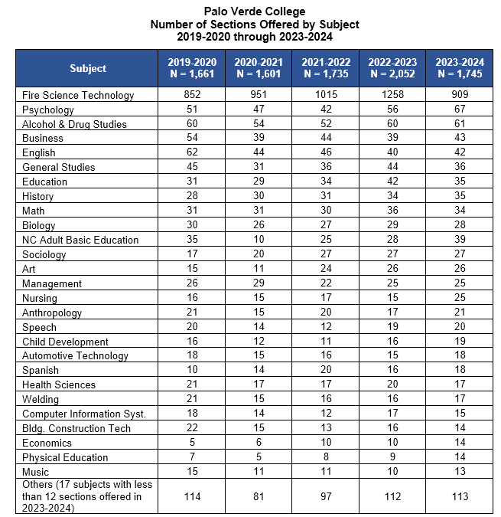

Slide 24
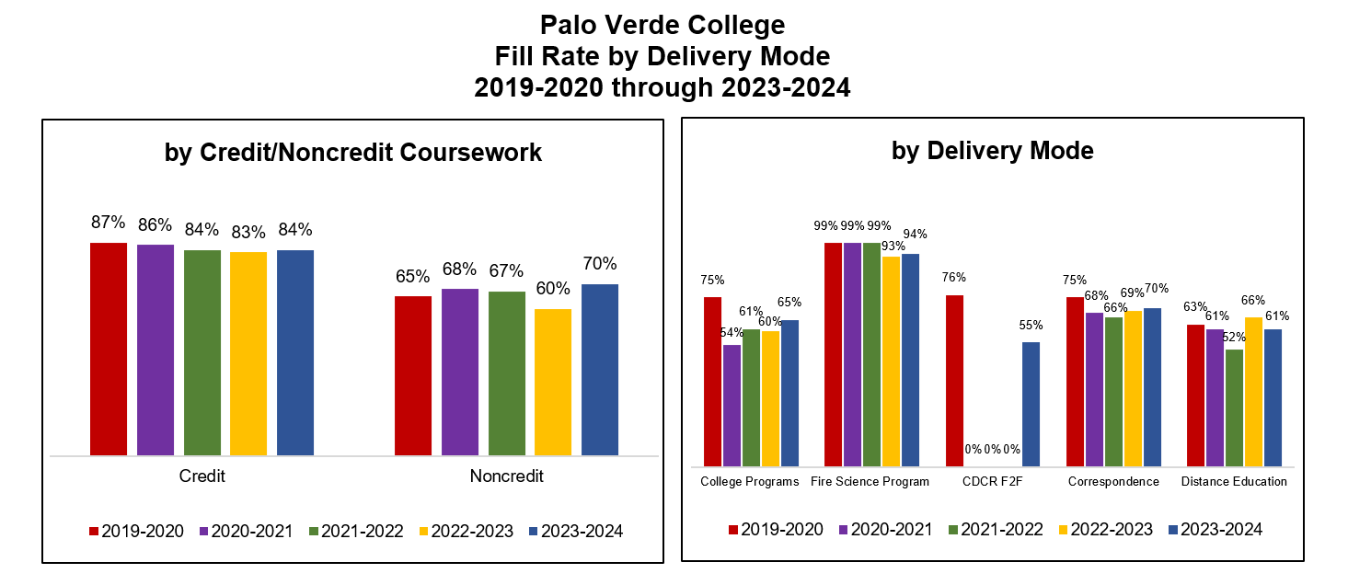

Slide 25
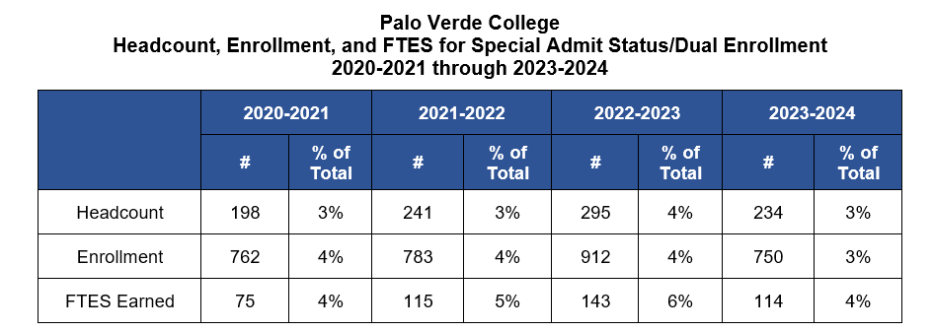

Slide 26
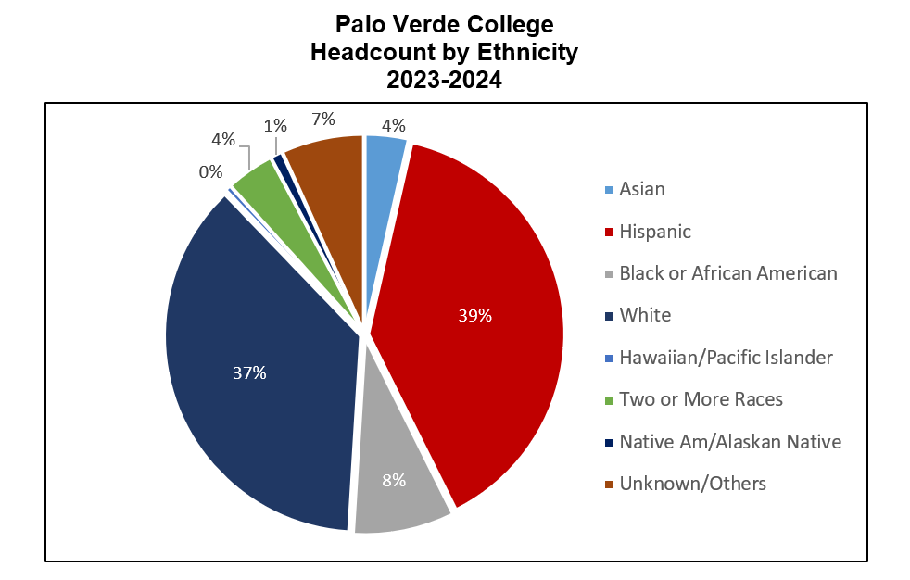

Slide 27
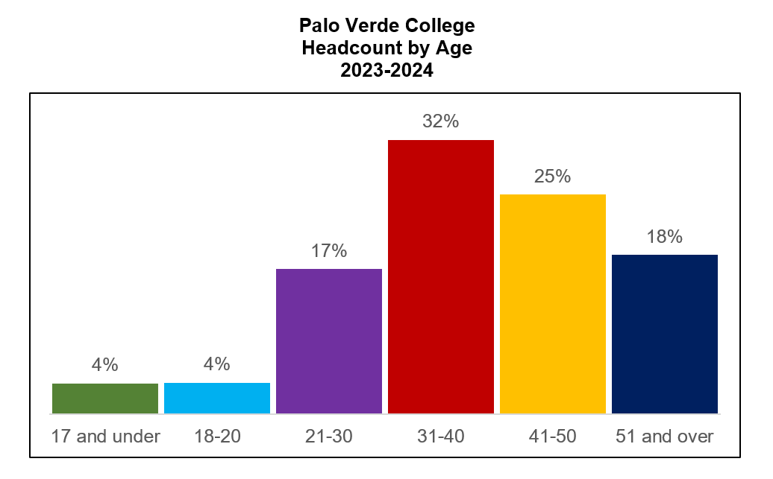

Slide 28
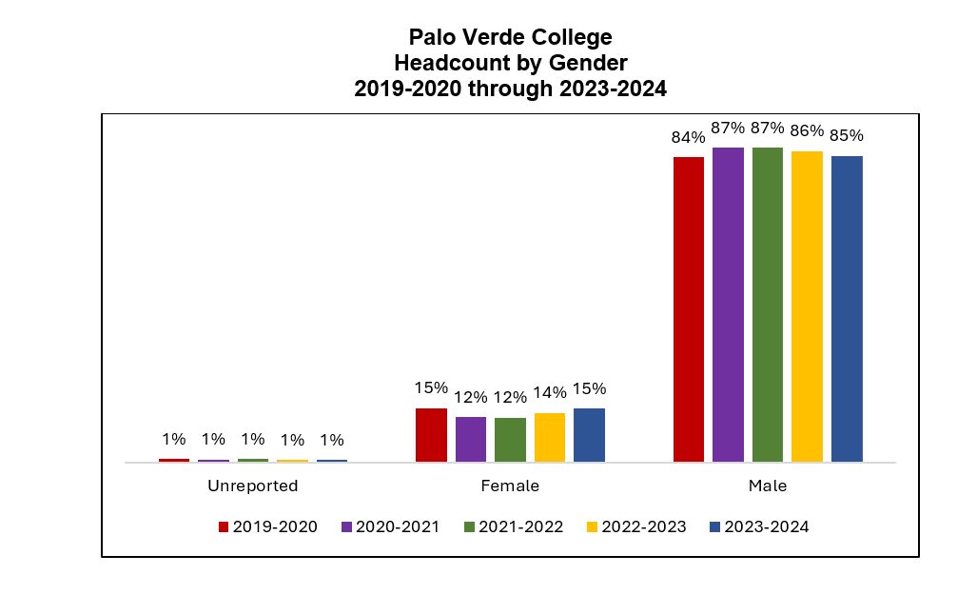

Slide 29
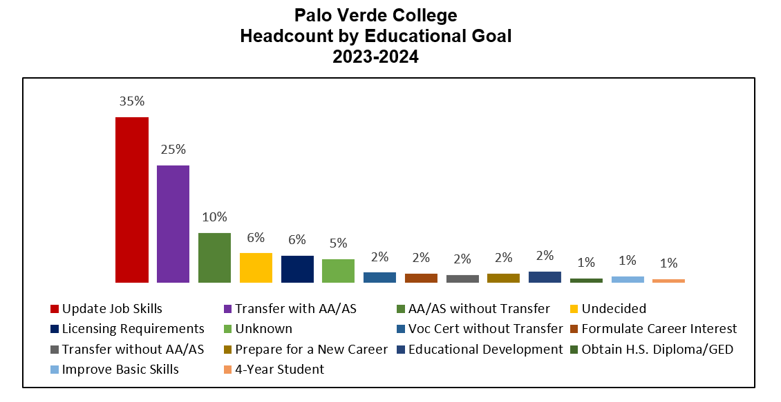

Slide 30
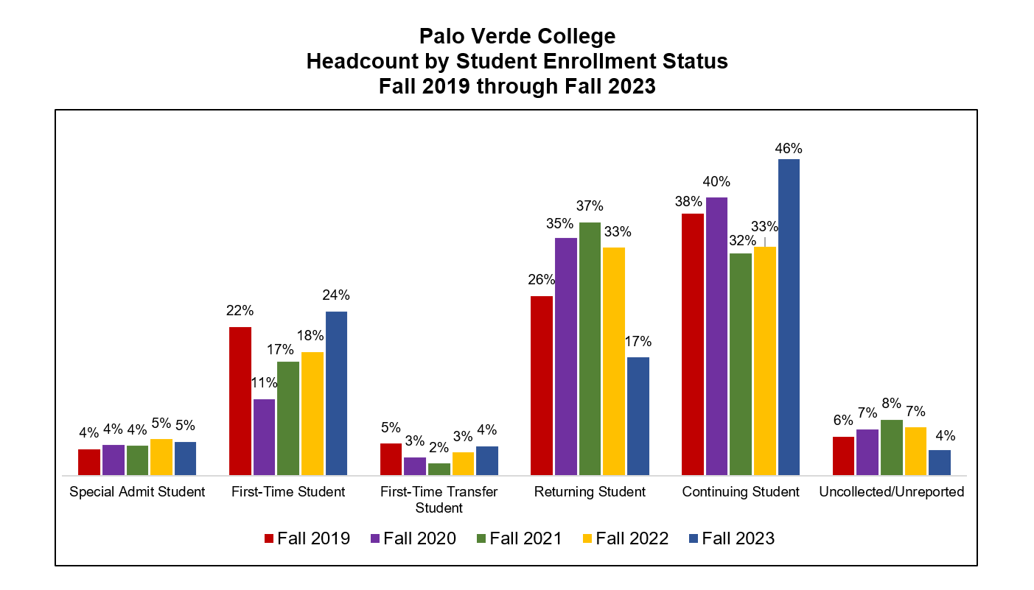

Slide 31
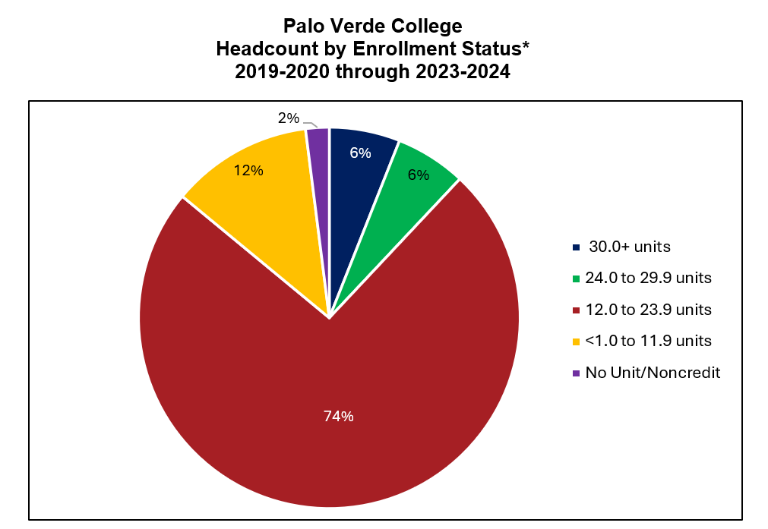

Slide 32
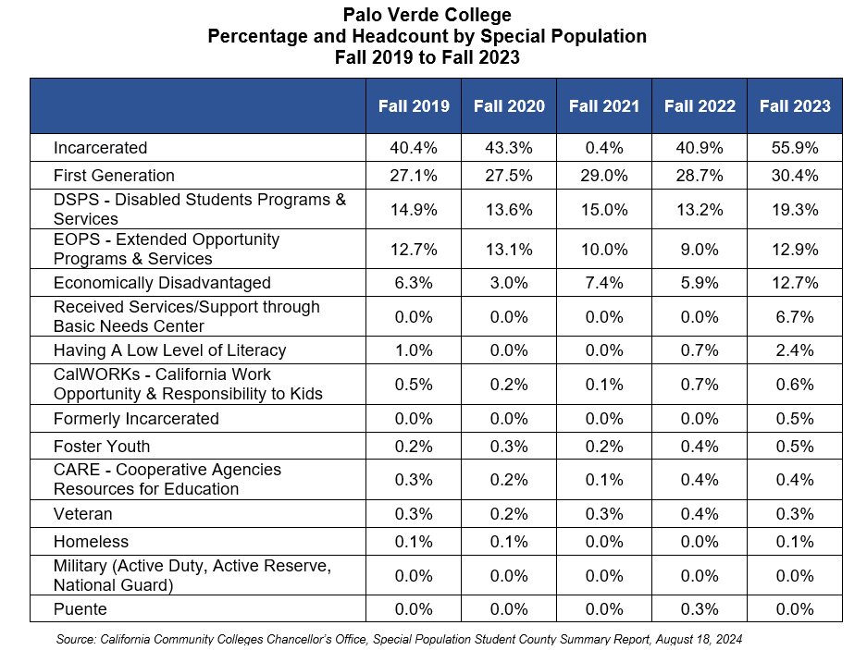

Slide 33
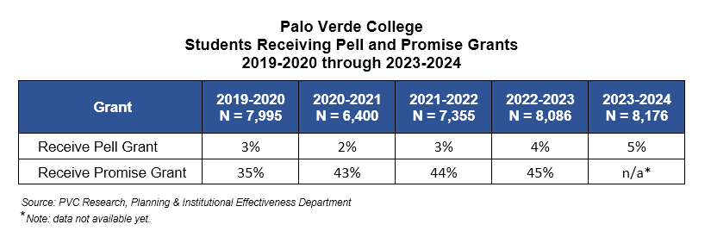

Slide 34
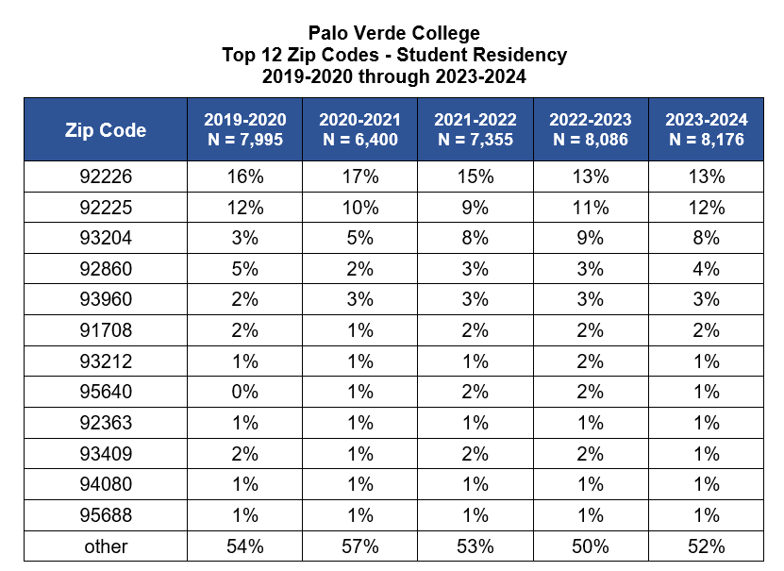

Slide 35
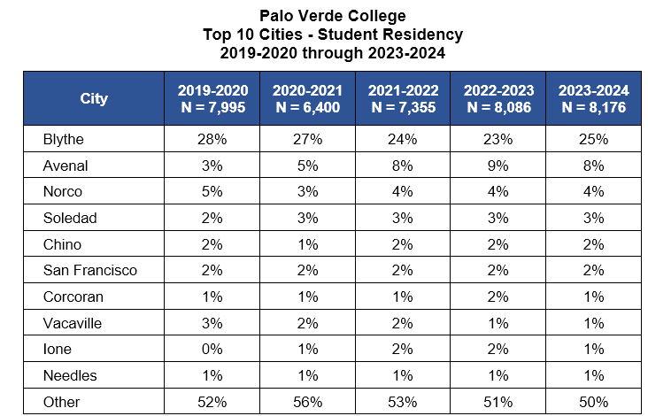

Slide 36

Internal Data Discussion

Slide 37
